Slide 1
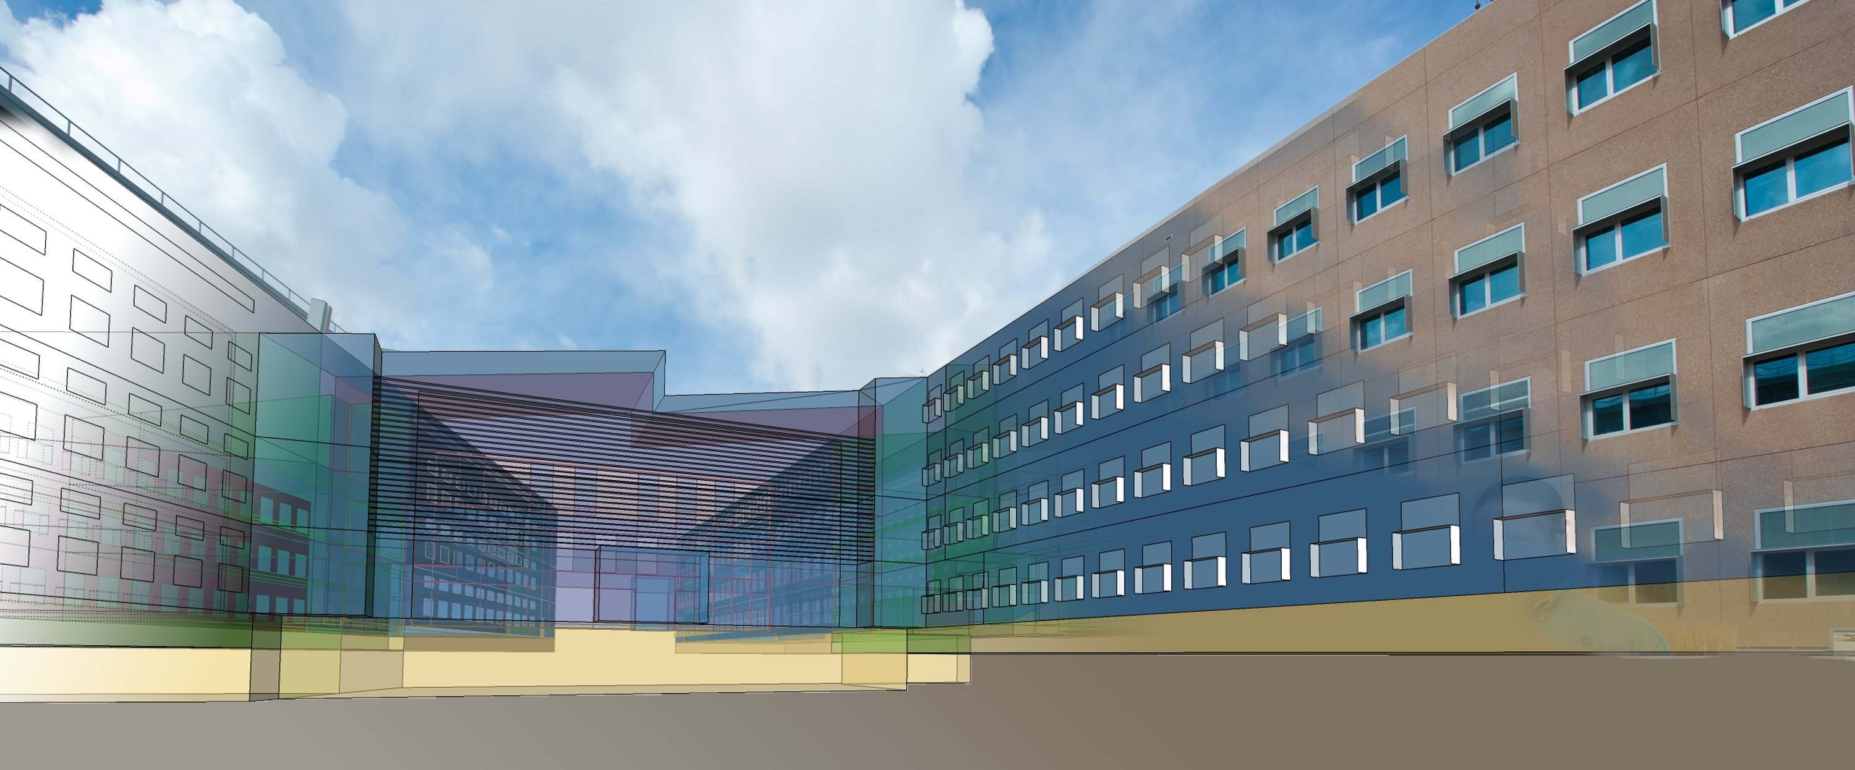
ESI Campus Modeling Platform
July 16, 2012

Slide 2
Virtual-Campus modeling Framework
BEMscape
OPAL RT
Chiller
Building 1 Load
Building 1 Load
Electrical Loop
BAS
(delta)
B1
Building 2 Load
Building 2 Load
B2
.
.
.
Heating loop
Control layer
Cooling loop
Building N Load
Building N Load
Electrical monitoring
PV1
PV2
Thermal
Central
Plant
EV1
Power
Site
Generation
EV2
Load
Ball
Electric Vehicles
Simulink Development Server
Various
Users
Brackney
Chakraborty
Weather, Utility Rate, etc.
Kramer
.
.
.
Timestep, Modified Schedules, etc.

Slide 3
Virtual-Campus modeling Framework
BEMscape
OPAL-RT, OP5600 HIL Box
Chiller
Building 1 Load
Building 1 Load
Electrical Loop
SimPowerSystems
BAS
(delta)
B1
Building 2 Load
Building 2 Load
B2
Heating loop
.
.
.
RT-LAB Orchestra API / OPC Server
RT-LAB Orchestra API
Cooling loop
SimScape
Building N Load
Building N Load
Electrical monitoring
PV1
PV2
Thermal
Central
Plant
EV1
Power
Site
Generation
EV2
Load
RT-LAB Host Workstation
12 core, Dell T7500 48GB
Ball
Electric Vehicles
Various
Matlab
Simulink
SimScape
SimPowerSystems
Simulink Coder
Matlab Coder
Visual Studio
Users
Brackney
Chakraborty
Weather, Utility Rate, etc.
Kramer
.
.
.
Timestep, Modified Schedules, etc.

